Slide 1
Manuscript Archive Projects in the English Department
Book of Margery Kempe
The Early Ruskin Manuscripts, 1826-42

Slide 2
A well formed and granular XML document
The purpose of XML encoding is to be able to do things with texts, not just to display them. That is why elements must describe the constituent parts of kinds of documents, and the grammar must place the elements in consistent relation.
If a scholar wants to analyze several poems using a computer, the poems must be marked up with elements that are both meaningful (<stanza>, <line>, and so on) as well as consistently named from one poem to the next.
In order, to carry out a computer-assisted analysis that is powerful, the mark-up should also be granular. That is, the mark-up should be subdivided enough that the document can be parsed into sufficiently small bits (bites, in the case of pies) for analysis.

Slide 3
An XML exercise: step 2
Try making your apple pie XML document more granular. How can you sub-categorize your mark-up? The ingredients list is a good place to start. Remember to maintain grammar rules.

Slide 4
SGML and its descendants
The parent language of HTML is SGML, which is a metalanguage.
That is, SGML is a set of rules for building a markup language.
HTML was developed from SGML as a stripped-down markup language, which could rely on a Web browser for its DTD. HTML became popular for its ease of linking documents and allowing mixing of text with images.
HTML lives in sin, because it violates the rule of separating information from the mode of displaying information.
XML is also a metalanguage, but it is a subset of SGML.
It is extensible, in that it allows one to invent elements (vocabulary), so long as one observes the grammar rules to produce a well formed XML document.
XML was developed to work smoothly with the Web, but it strictly observes separation of information and display.
Because virtue always triumphs, XML is displacing HTML.

Slide 5
TEI/XML: Who are these people and why are they telling me what to do?
TEI/XML is a markup language that is conformant with SGML, and that establishes a standard markup for information we want to preserve indefinitely.
The TEI was developed in the 1980s, adopted widely as a standard by libraries and publishers in the 1990s, and embraced and mastered by individual scholars in the 2000s.
The TEI Consortium is a nonprofit organization supported by its members – libraries, universities, and other academic concerns.
The consortium adjudicates growth of TEI elements and publishes the revised language periodically (current version is P5).

Slide 6
Whose validity?
English majors possess another skill, with which we torment people in other majors. Having described texts, we analyze the descriptions, and then we argue with each other endlessly about our analyses.
Revenge of the English majors: Notice that a DTD is already an analysis of a document, in that it codifies what someone believes to be the rules defining the grammar and vocabulary of that document. Interpretations are inescapable.
If you’re a typical class of English majors, you’ve come up with several different markups of your apple pie recipes. Each of you could proceed to write a DTD to codify the validity of your markup.
XML is extensible. That is, XML is designed to adapt to varying document types, and to interpretations of those document types (DTDs).
But . . . squabbling English majors, each armed with a DTD machine to prove himself or herself right, are not necessarily helpful for scholarship. What to do?

Slide 7
The Text Encoding Initiative (TEI)
What is needed is an XML markup scheme (a schema or DTD) both that enables scholars to exchange information and that remains flexible enough to describe a document as subtle as a Komunyakaa poem.
Such a schema must possesses
a uniform vocabulary of elements so that XML encoded documents can be shared in interoperable systems;
plus a means of adding flexibility to describe complex, unique documents.
The TEI is a worldwide consortium that agrees on this common ground for the benefit of scholarship. All major scholarly presses, libraries, and affiliated institutions have signed on to employ the TEI standard. XML/TEI is now a required language for our profession.

Slide 8


Slide 9
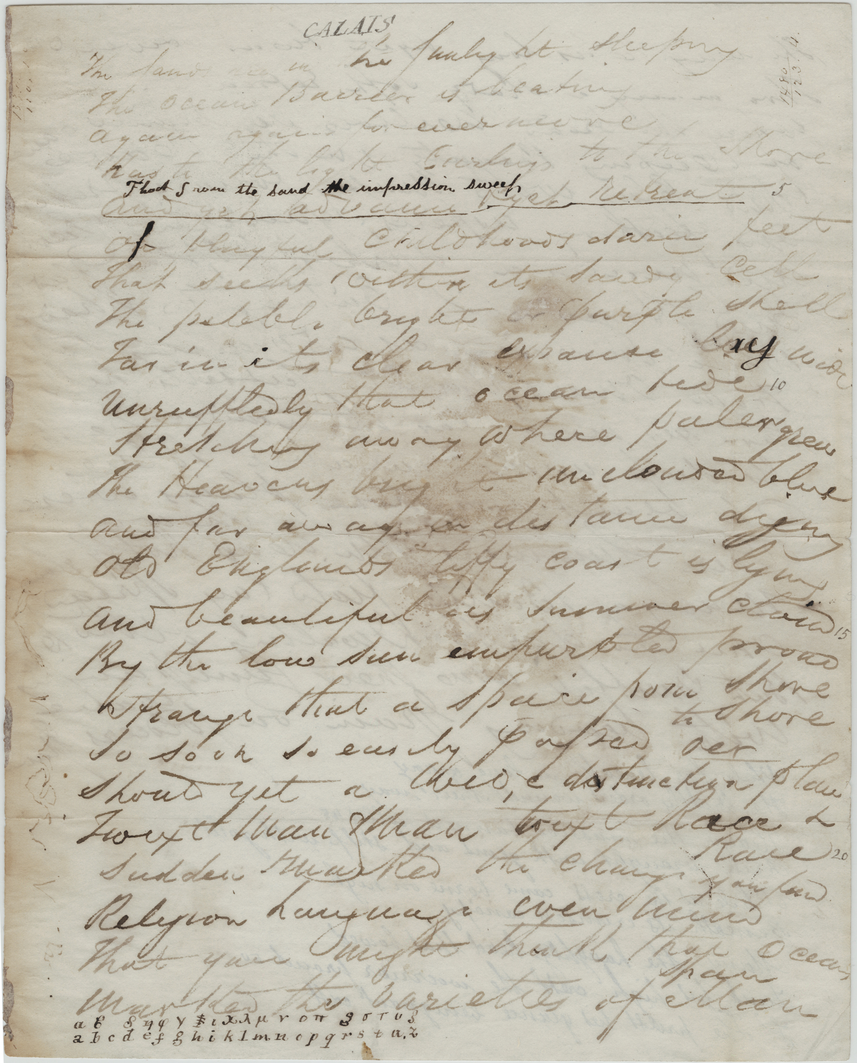

Slide 10
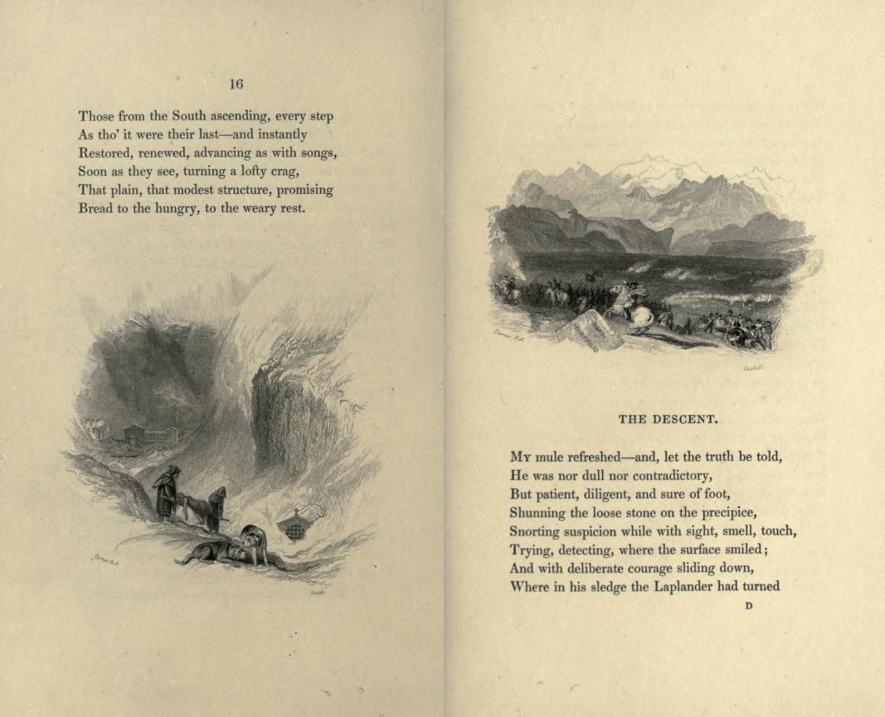

Slide 11
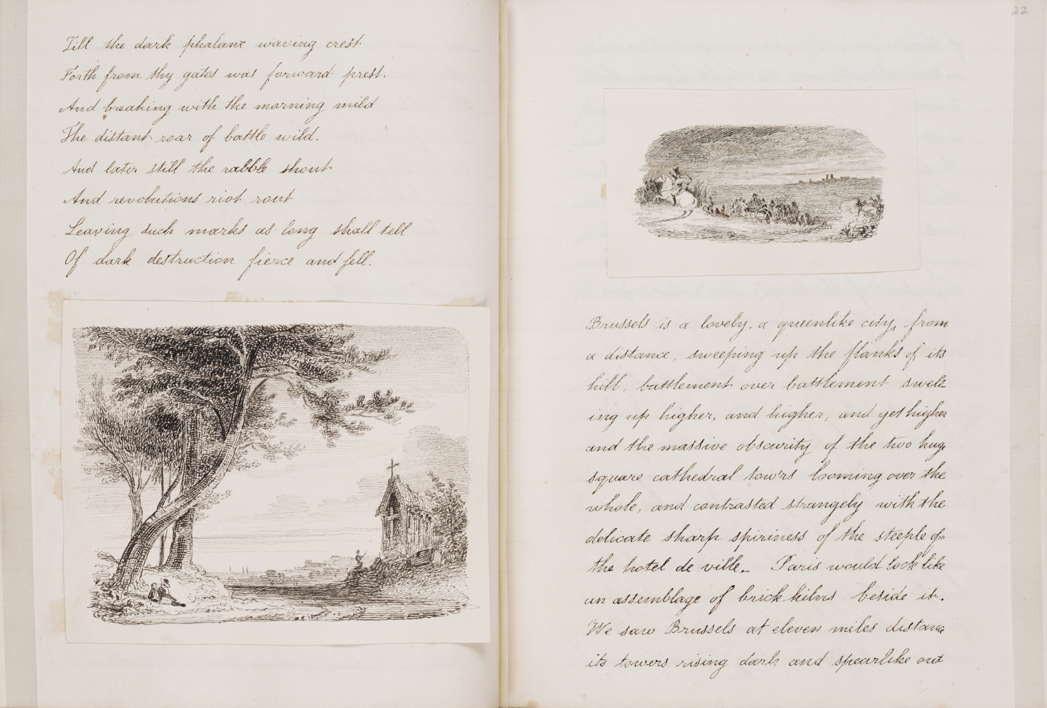

Slide 12
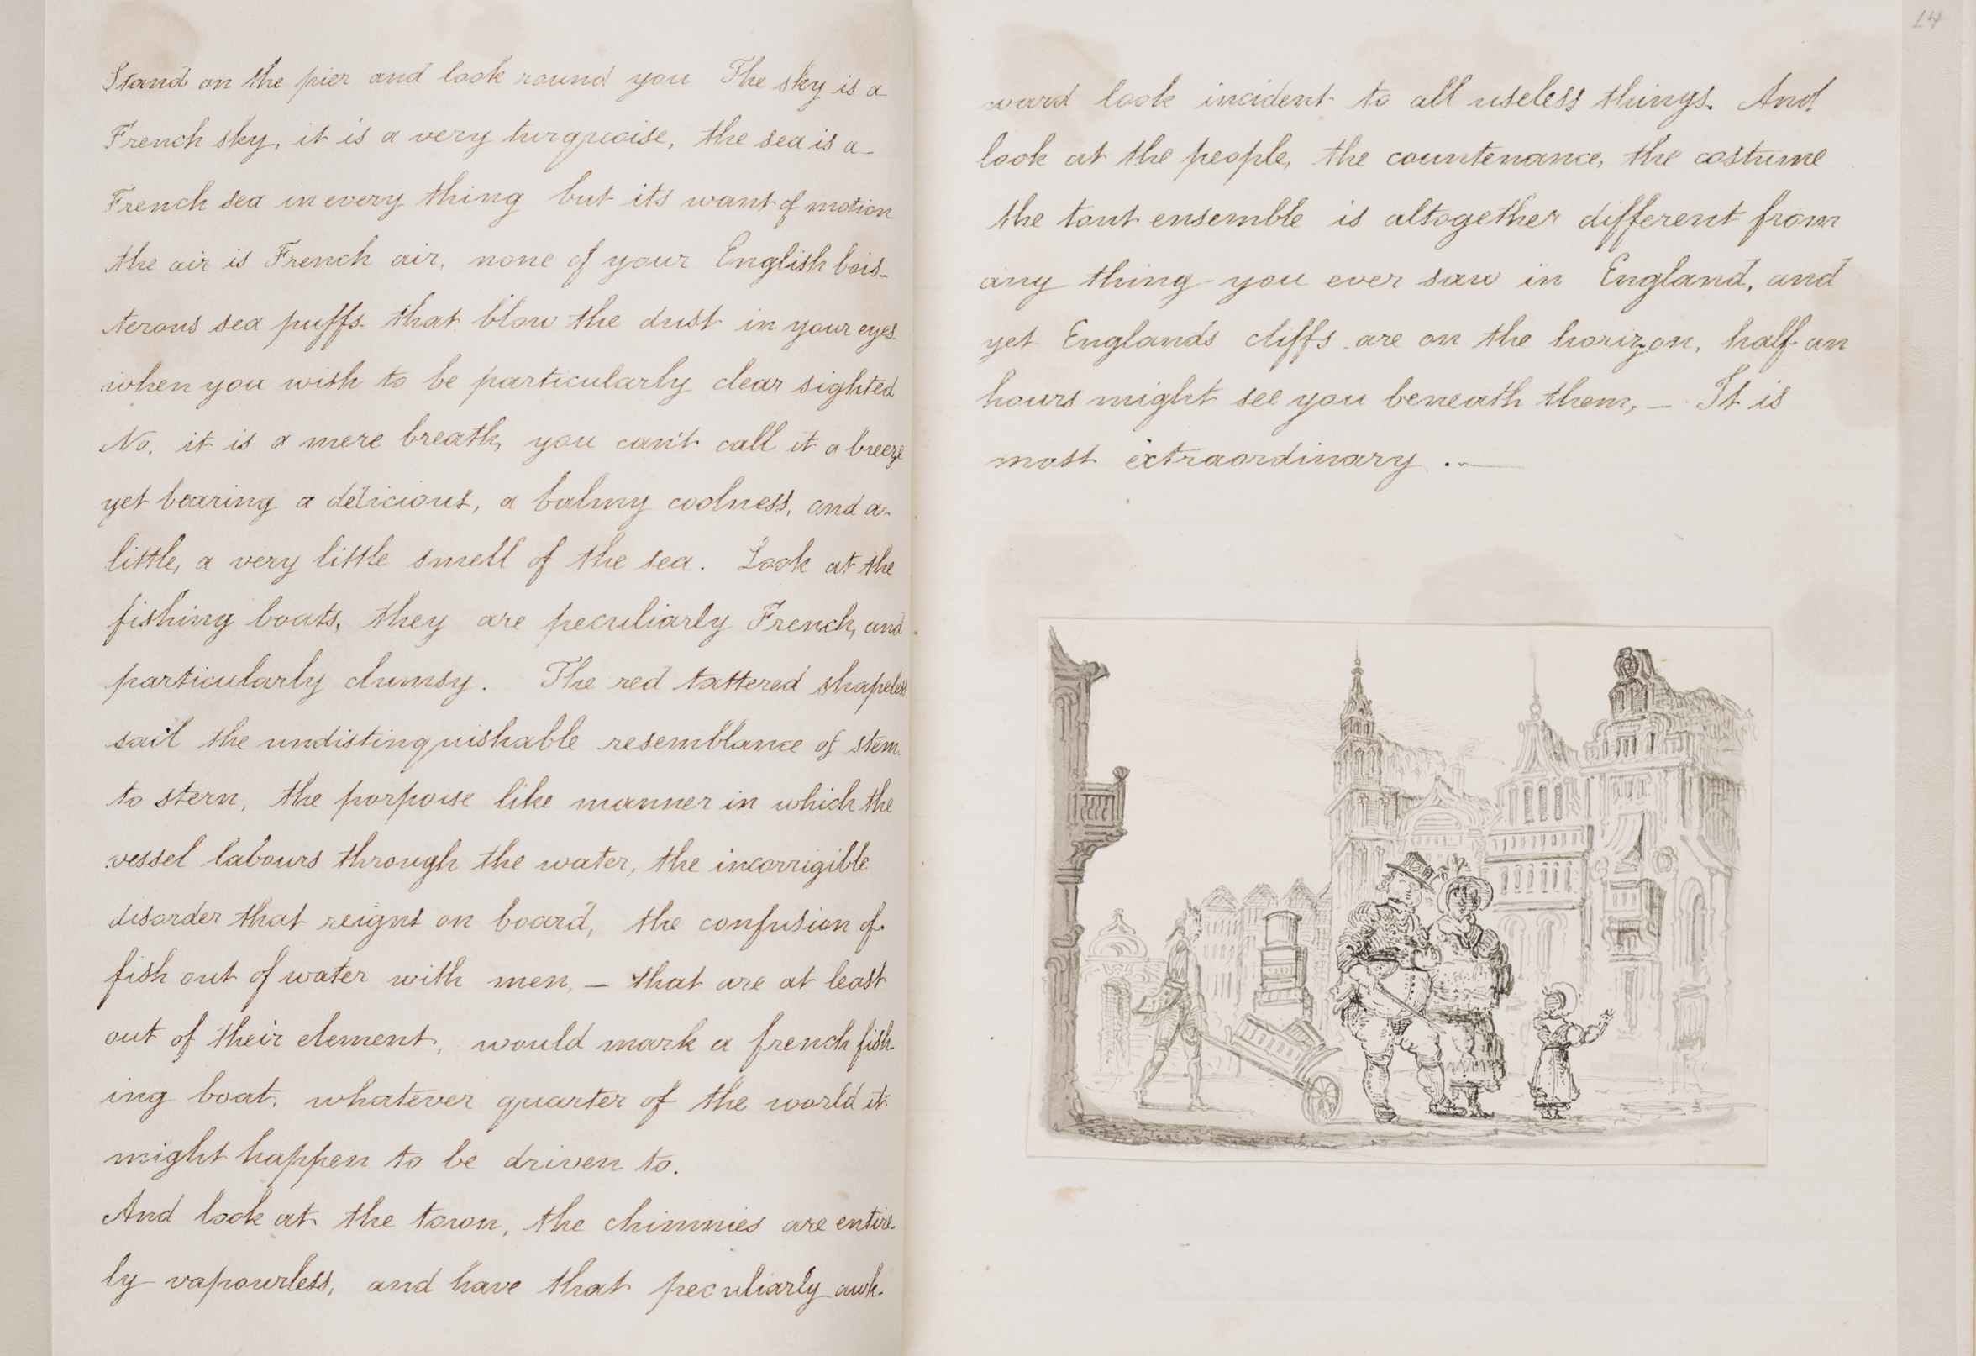

Slide 14
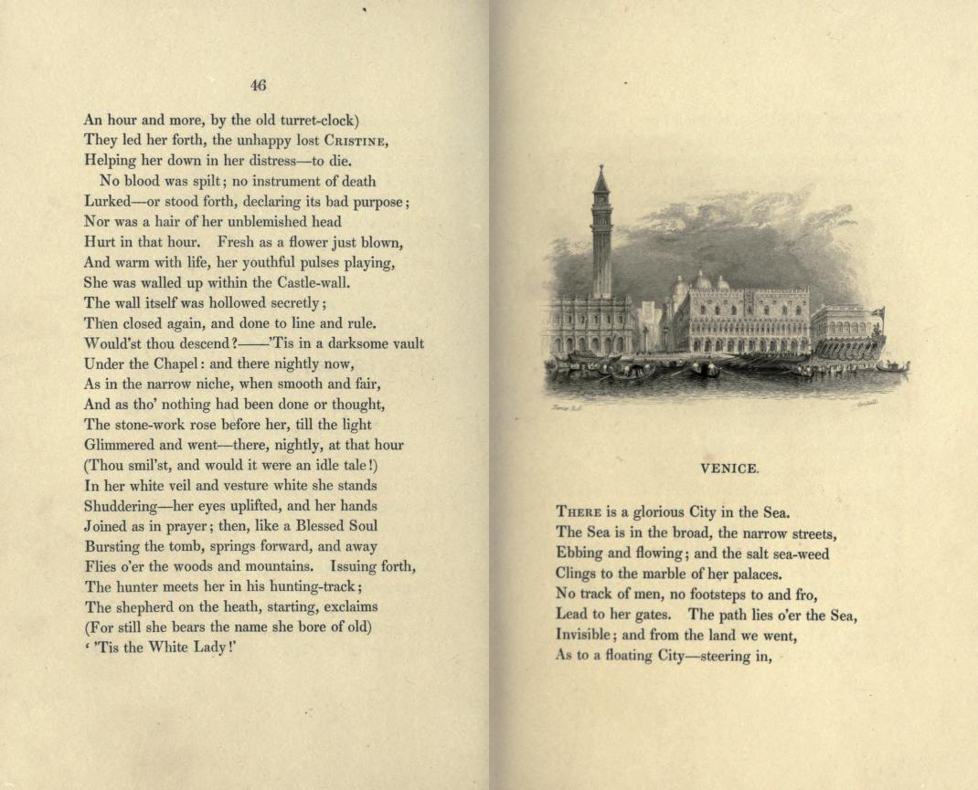

Slide 15
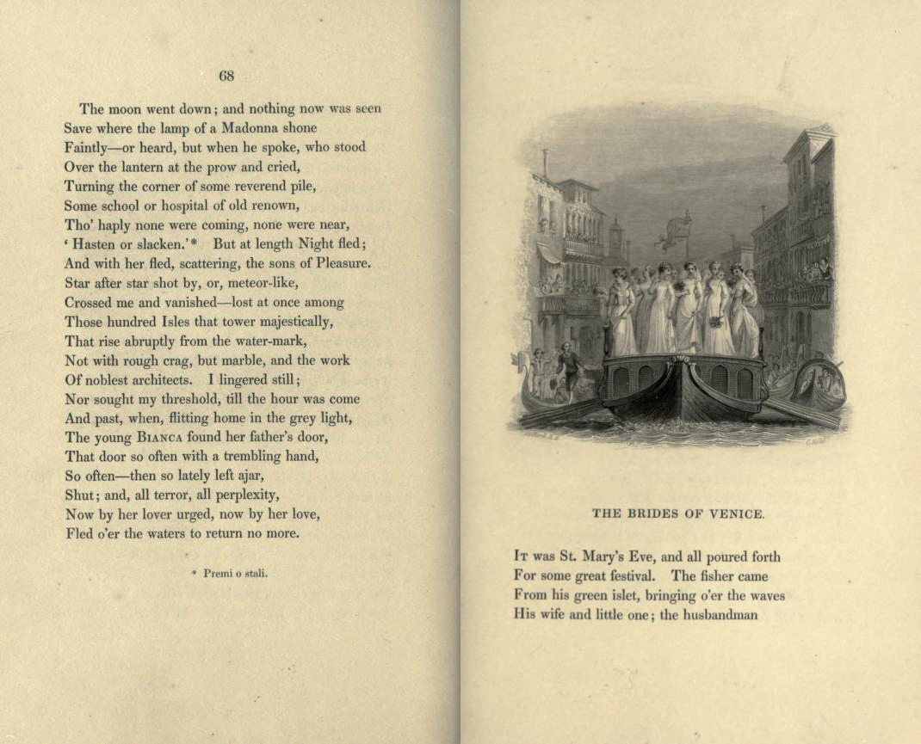

Slide 16
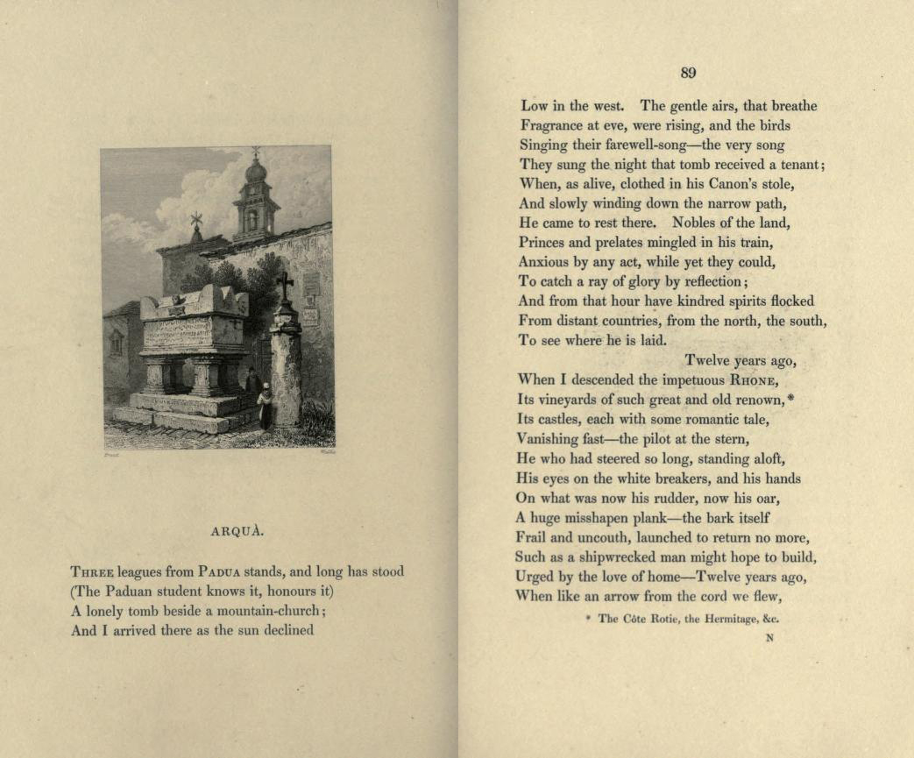

Slide 17
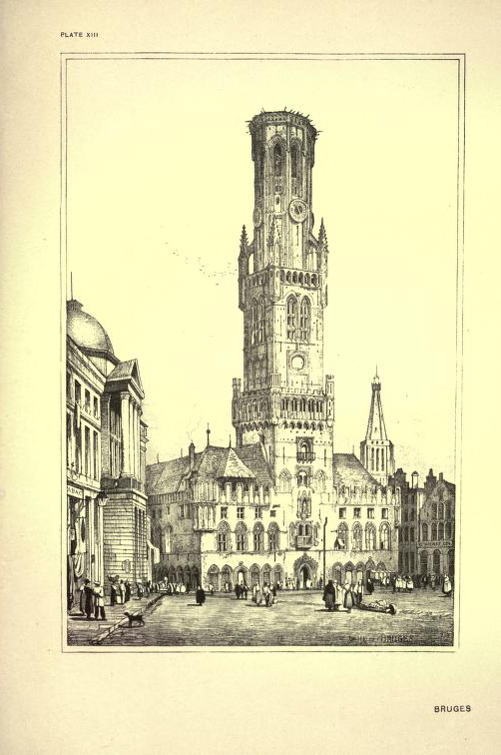

Slide 18
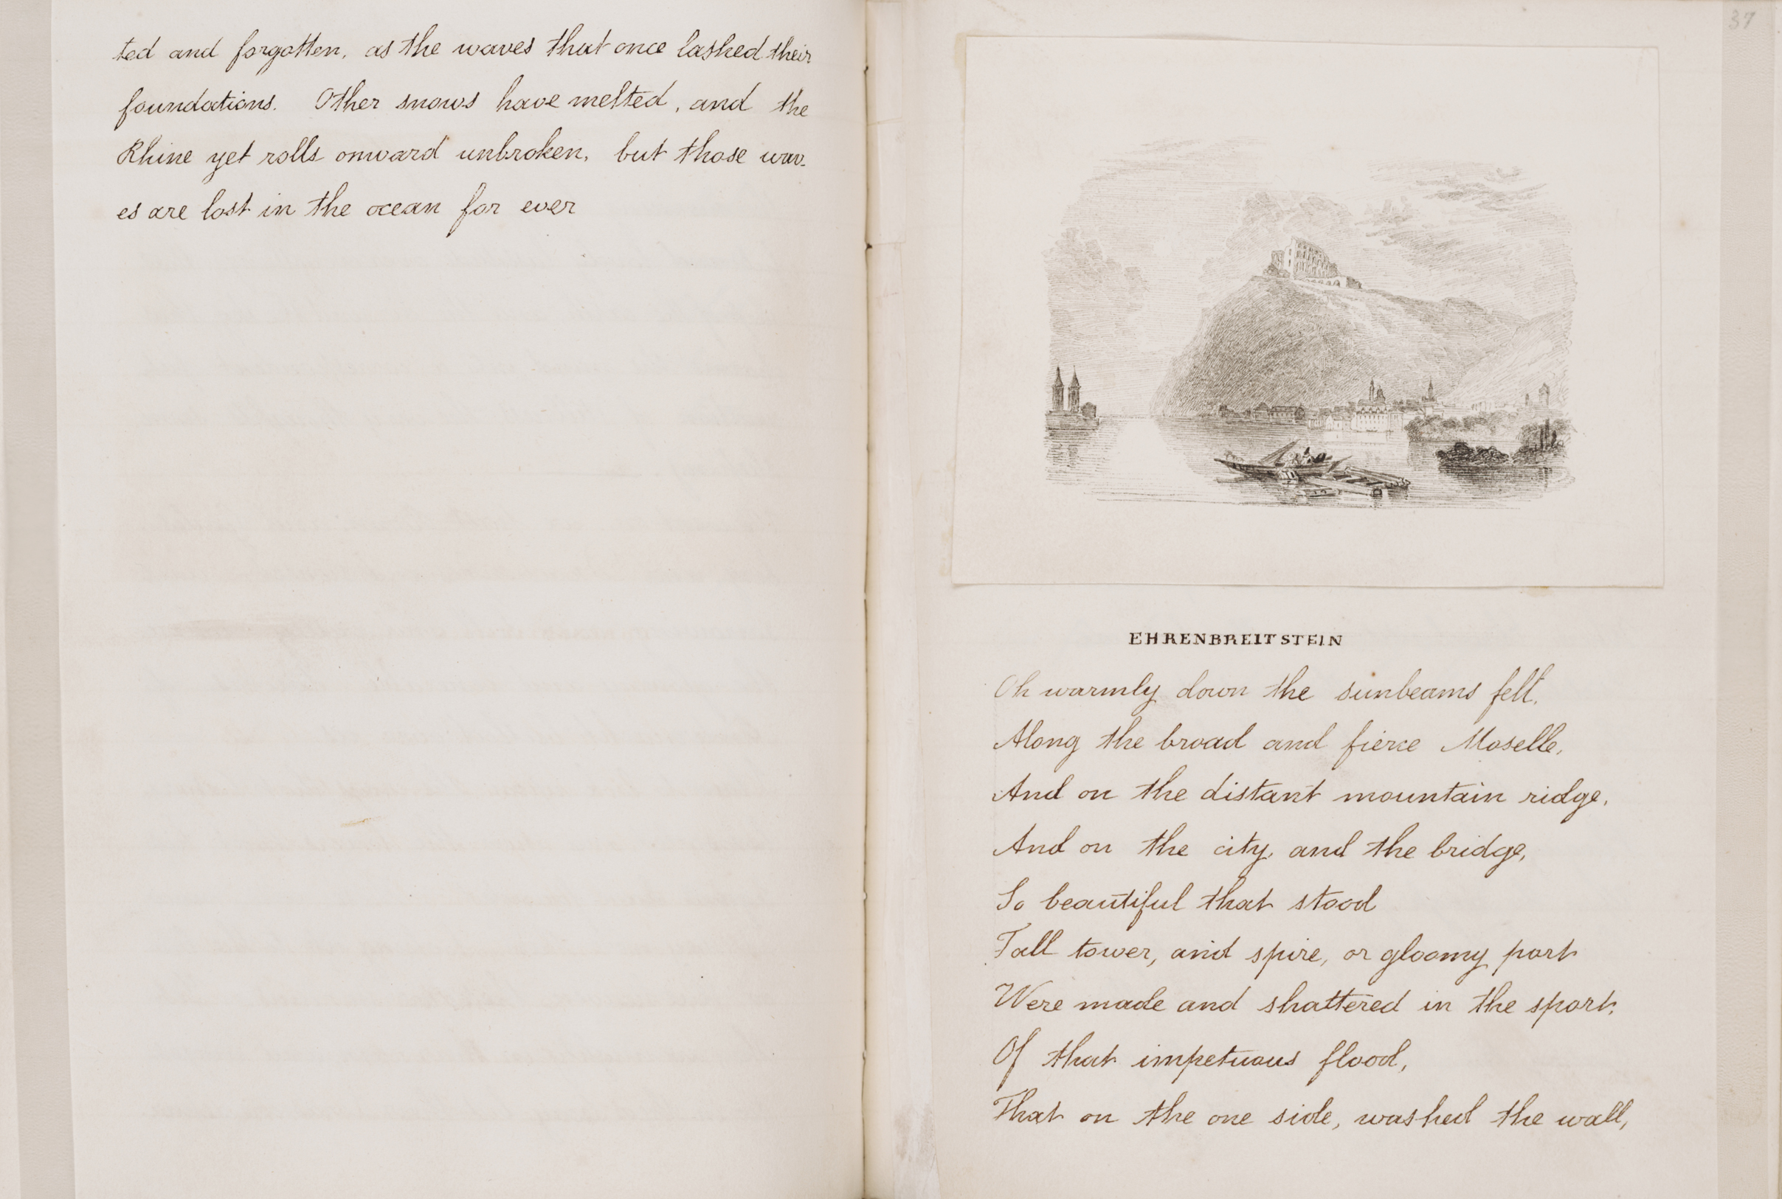

Slide 19
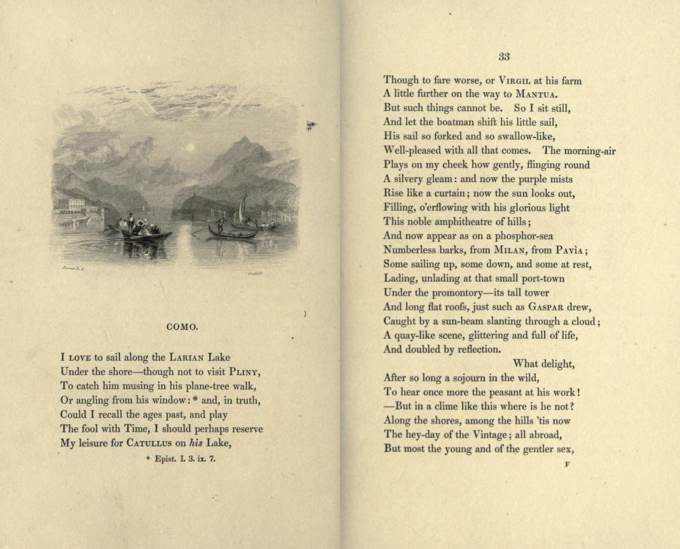

Slide 20
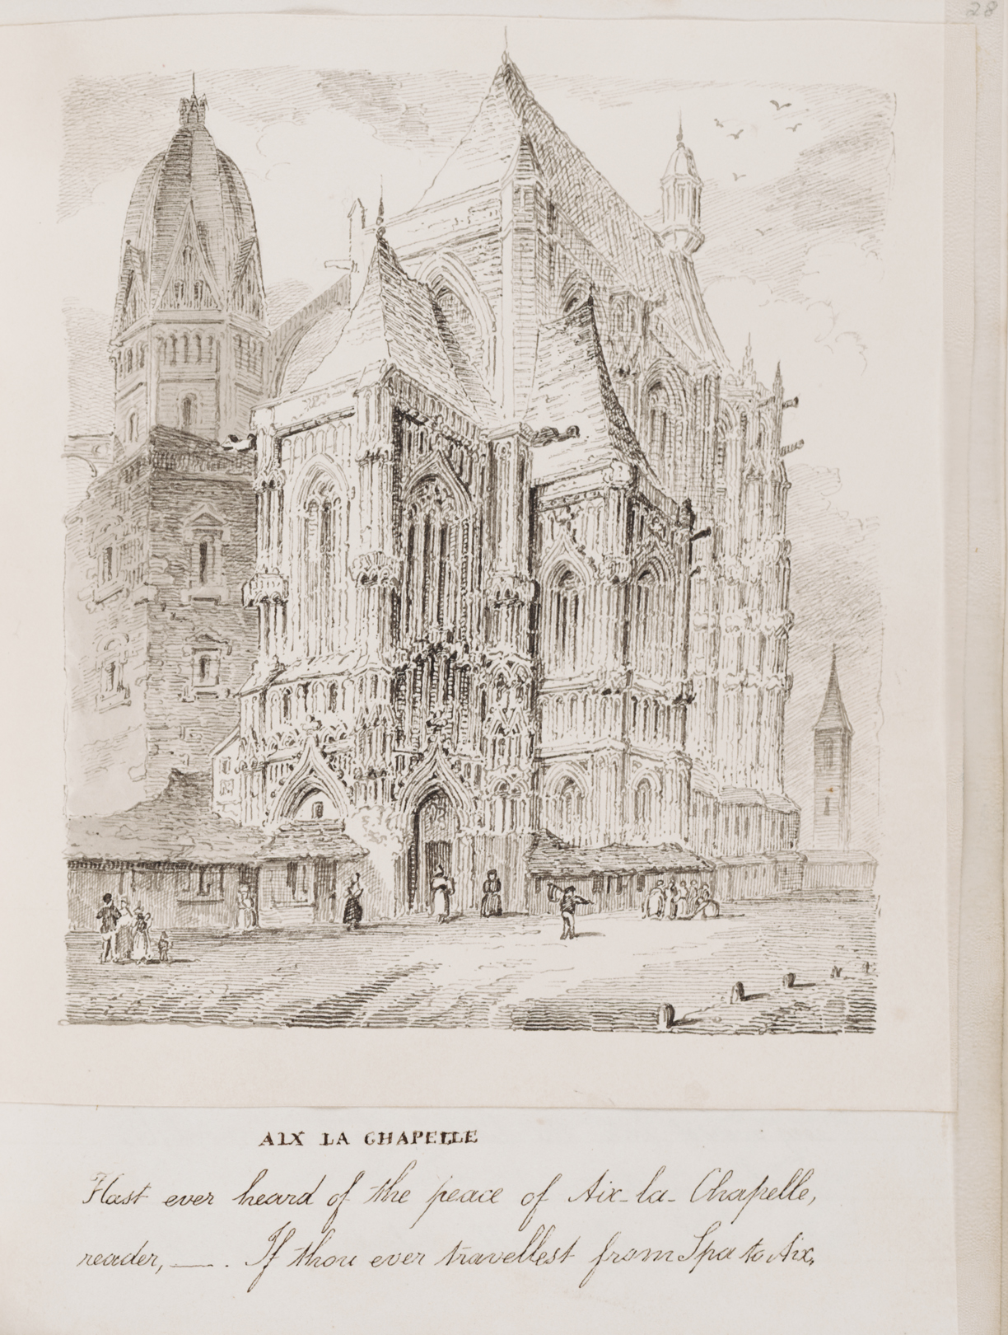

Slide 21
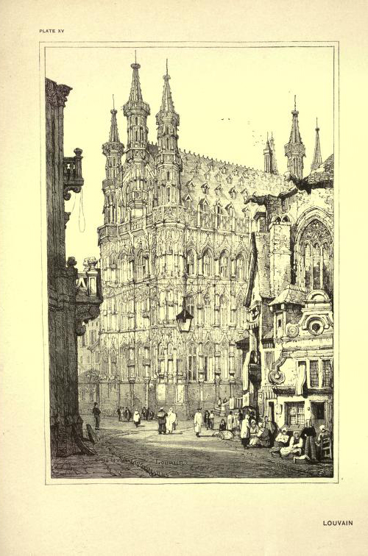

Slide 22
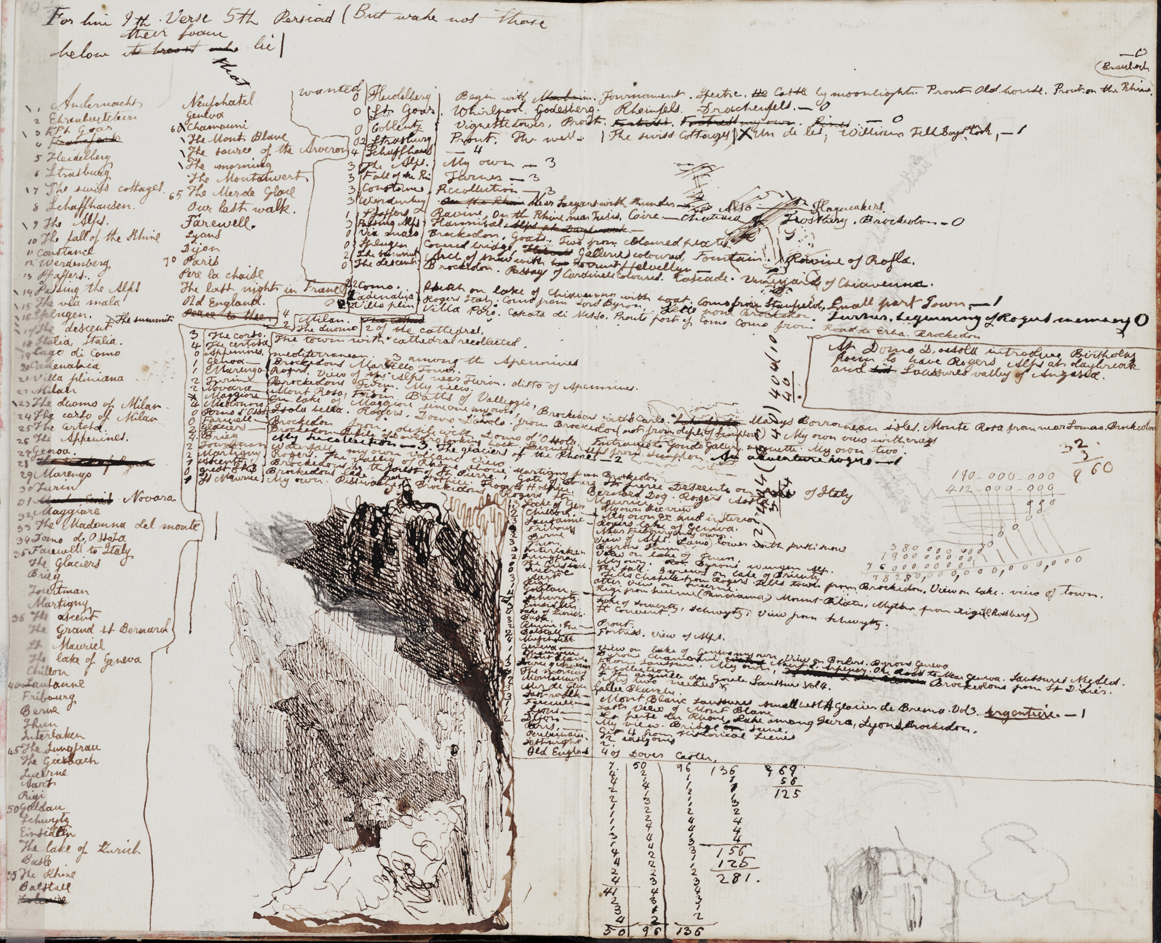

Slide 23
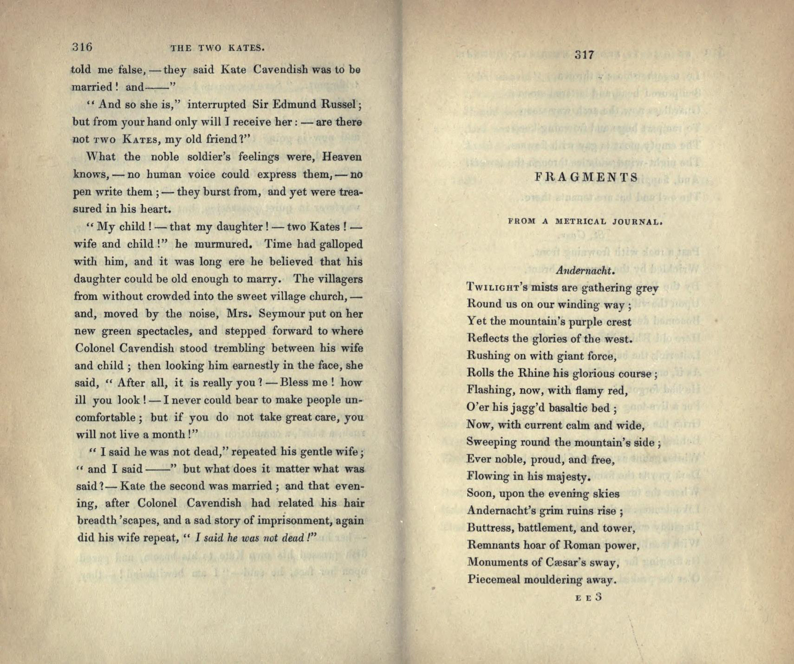

Slide 24
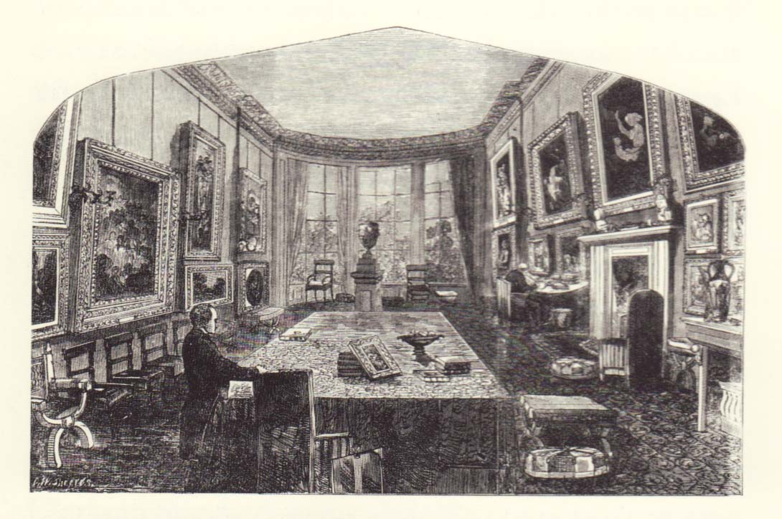

Slide 25
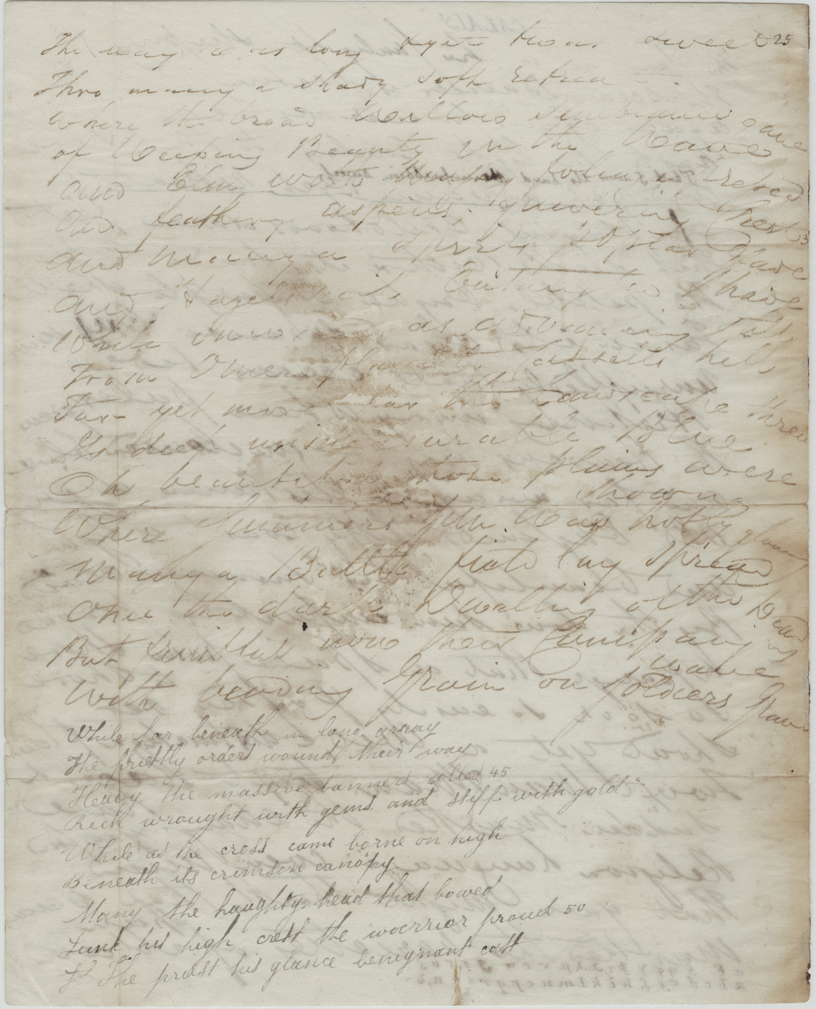

Slide 26
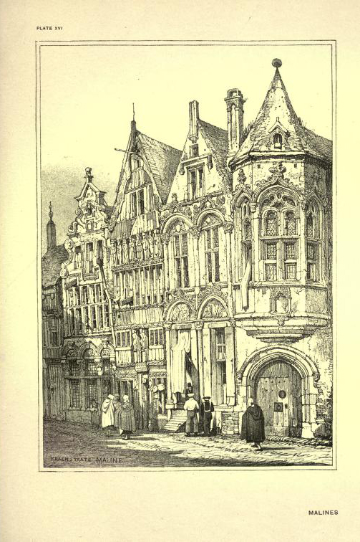

Slide 27
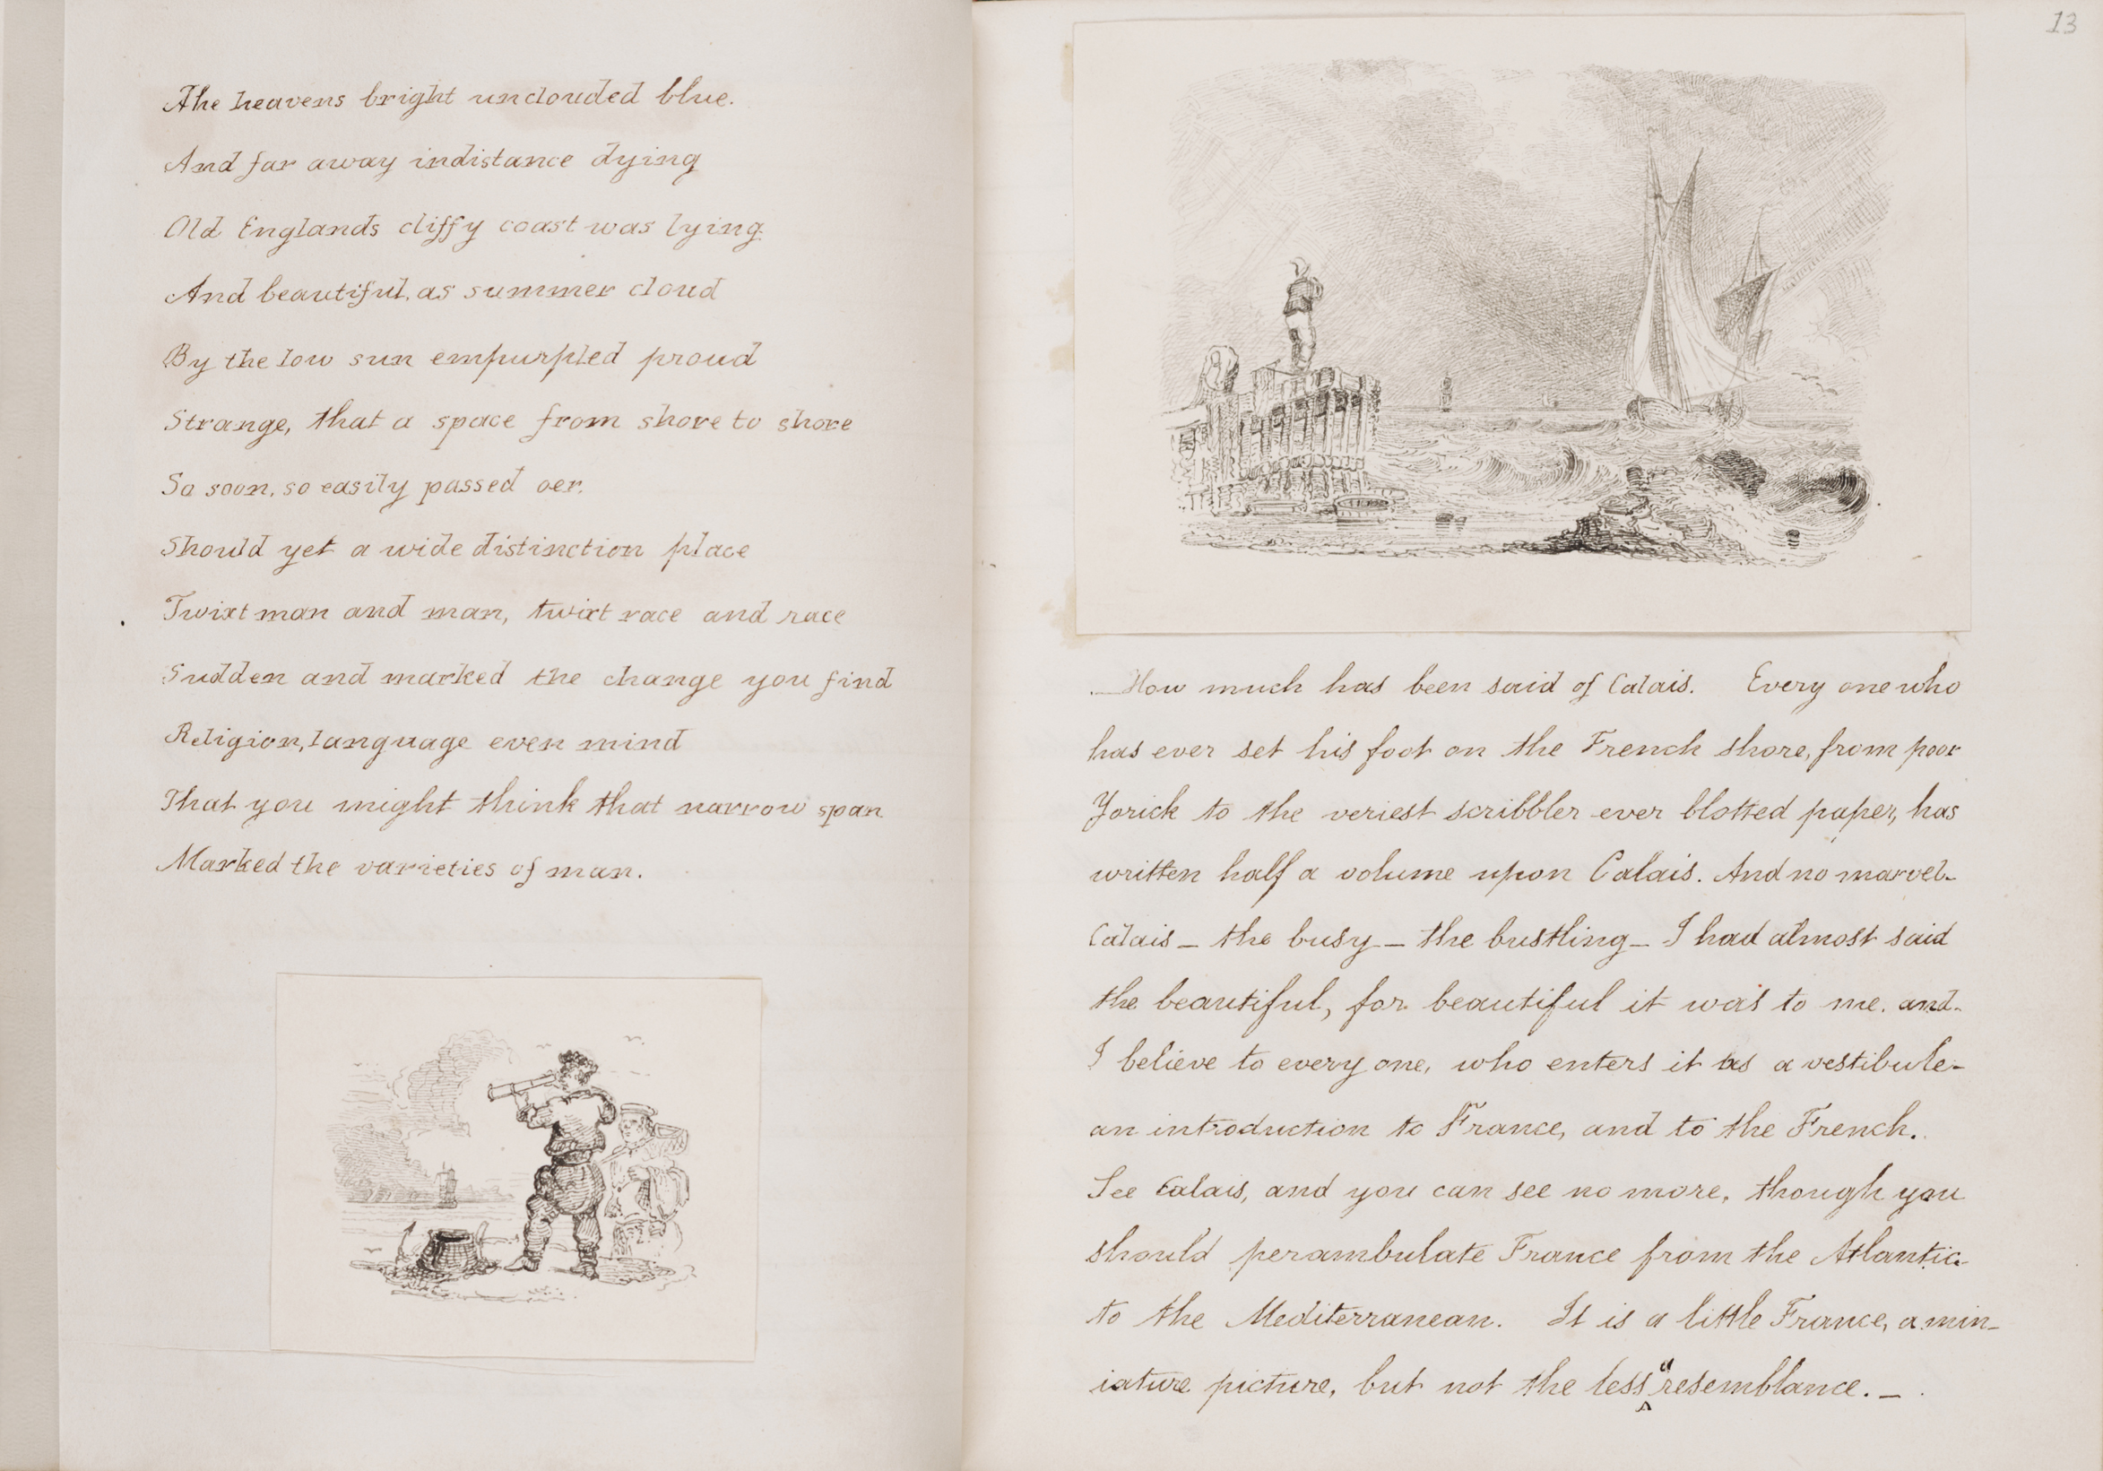

Slide 28
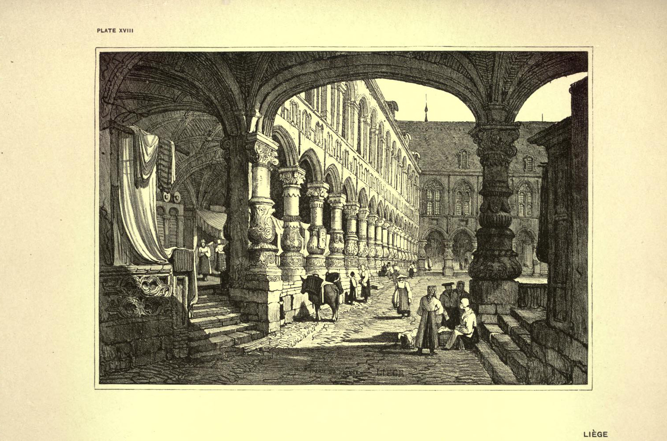

Slide 29
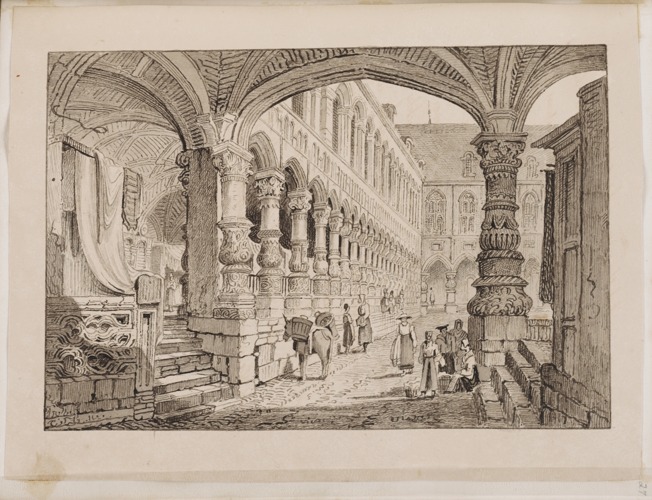

Slide 30
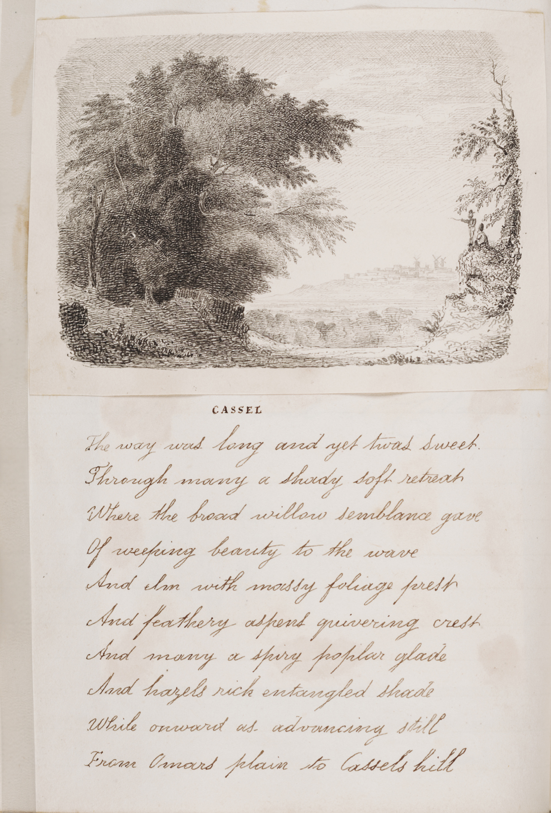

Slide 31
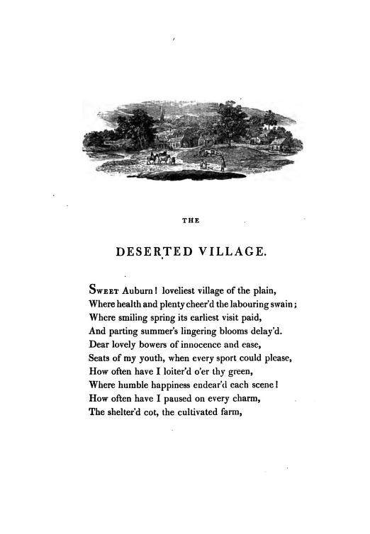

Slide 32
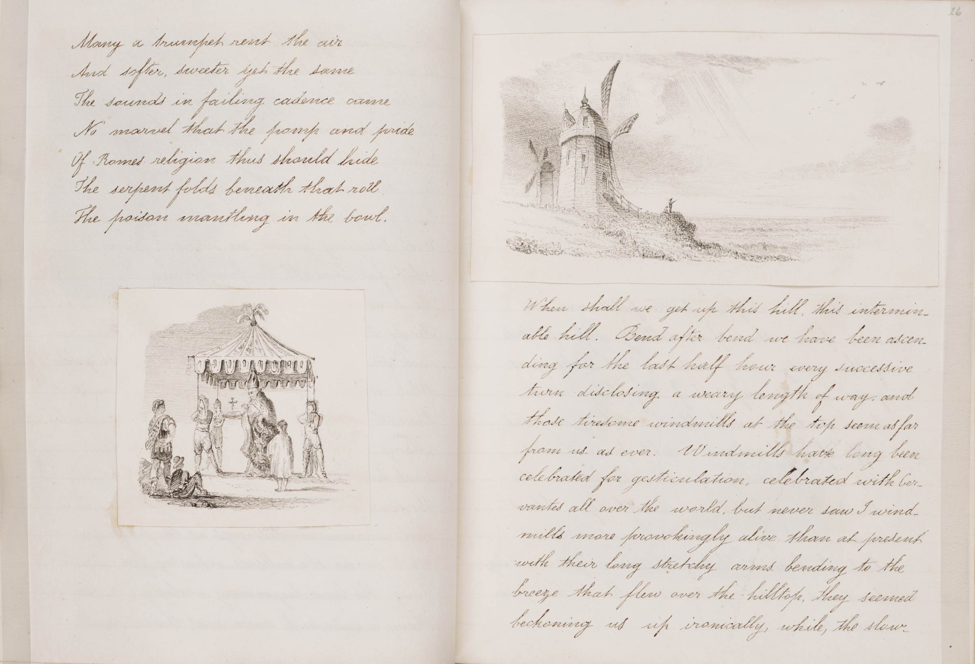

Slide 33
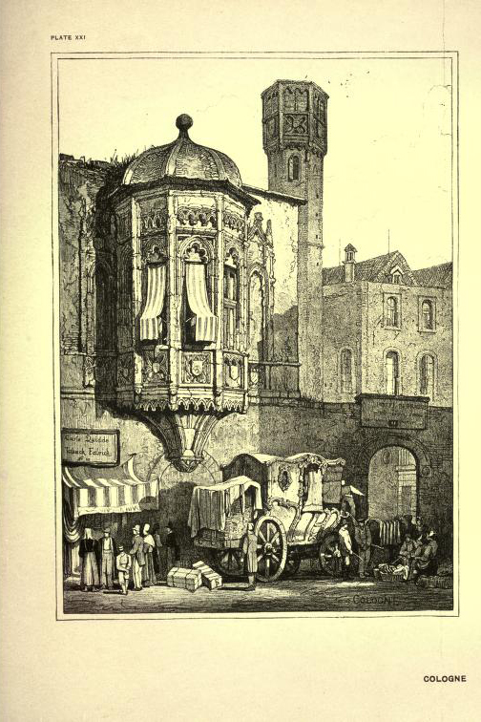

Slide 34
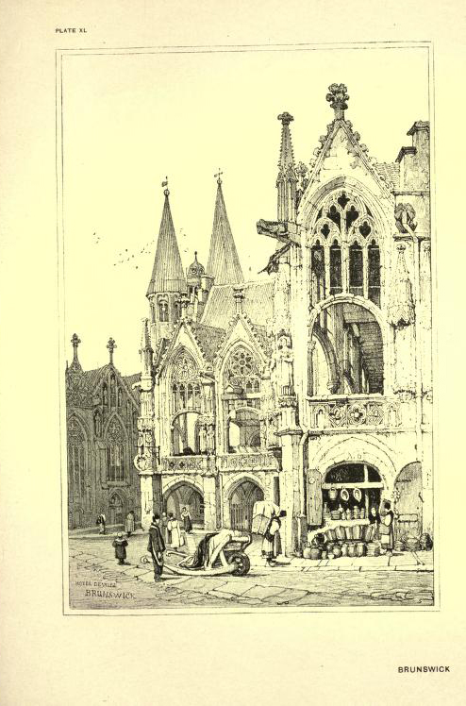

Slide 35
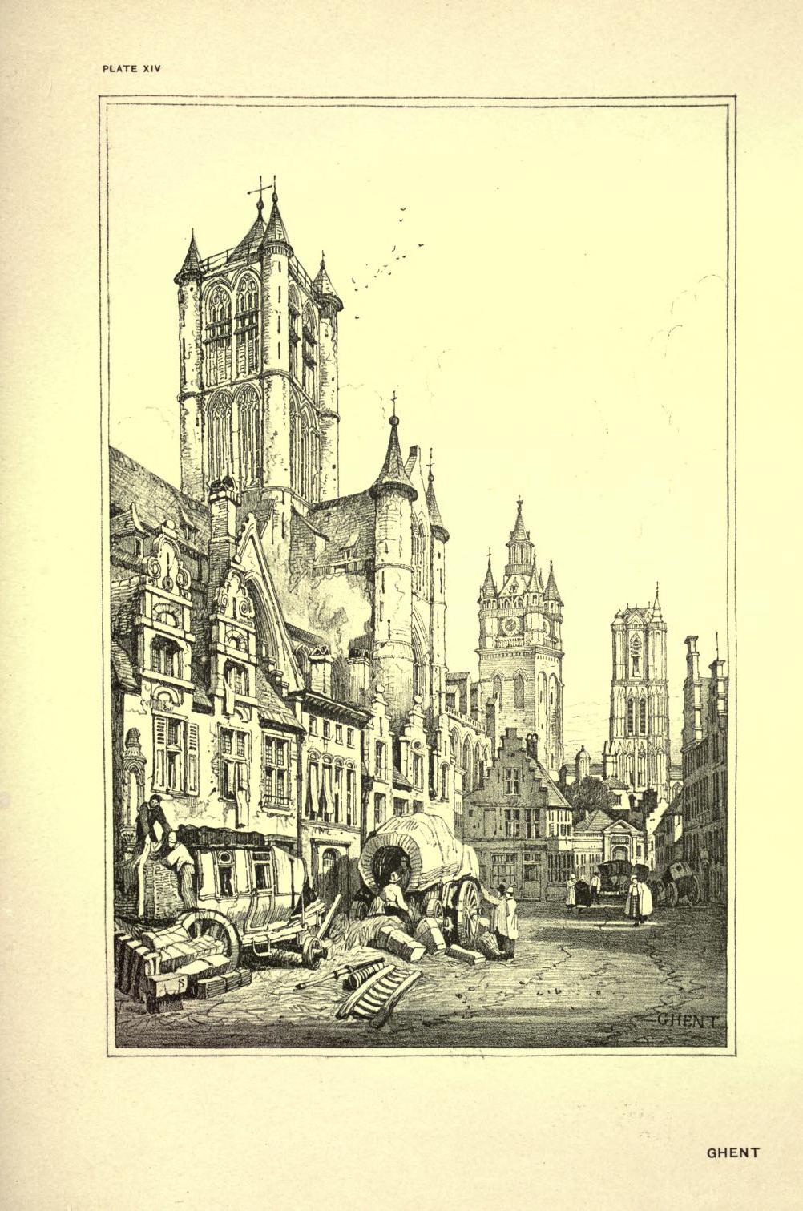

Slide 36
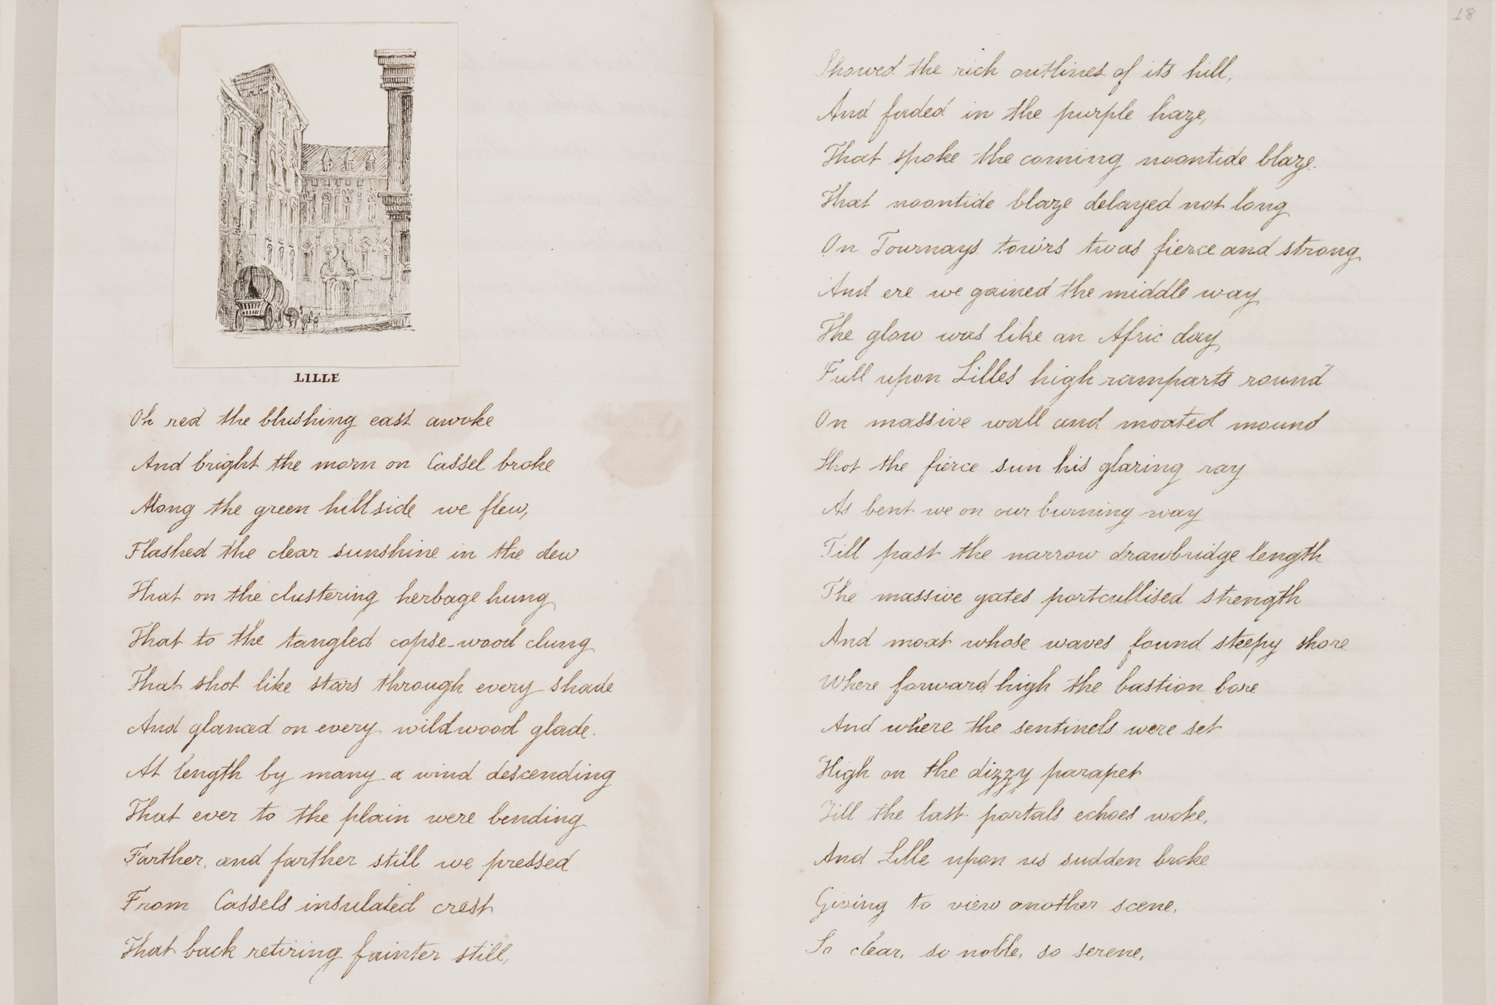

Slide 37
